Slide 1
Devyatka Buckwheat Evaluation of a determinate variety

Slide 2
Project Description
Increase a variety of buckwheat from the Ukraine and compare it’s characteristics of with those of available varieties grown in North Dakota, and make seeds and data available.

Slide 3
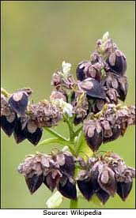
Девятка
Dev-YAHT-ka
Devyatka

Slide 4
Buckwheat variety selection
Variety selection limited
Variety availability
Access to new varieties can be limited to contracts
All varieties are indeterminate

Slide 5
Ecosystem services buckwheat provides
Weed suppression
Nutrient addition
Erosion control
Tilth improvement

Slide 6
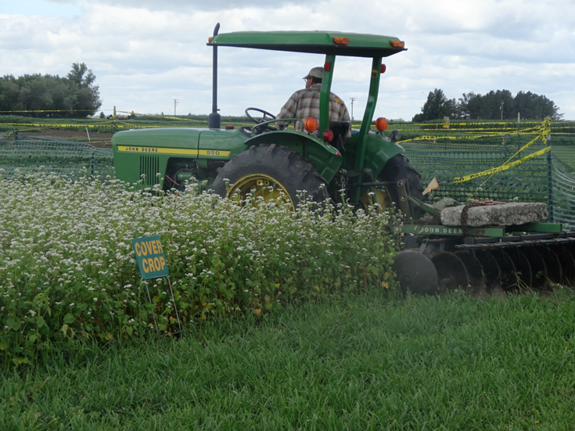
Cover crop use
Long flowering periods
Habitat for pollinators

Slide 7
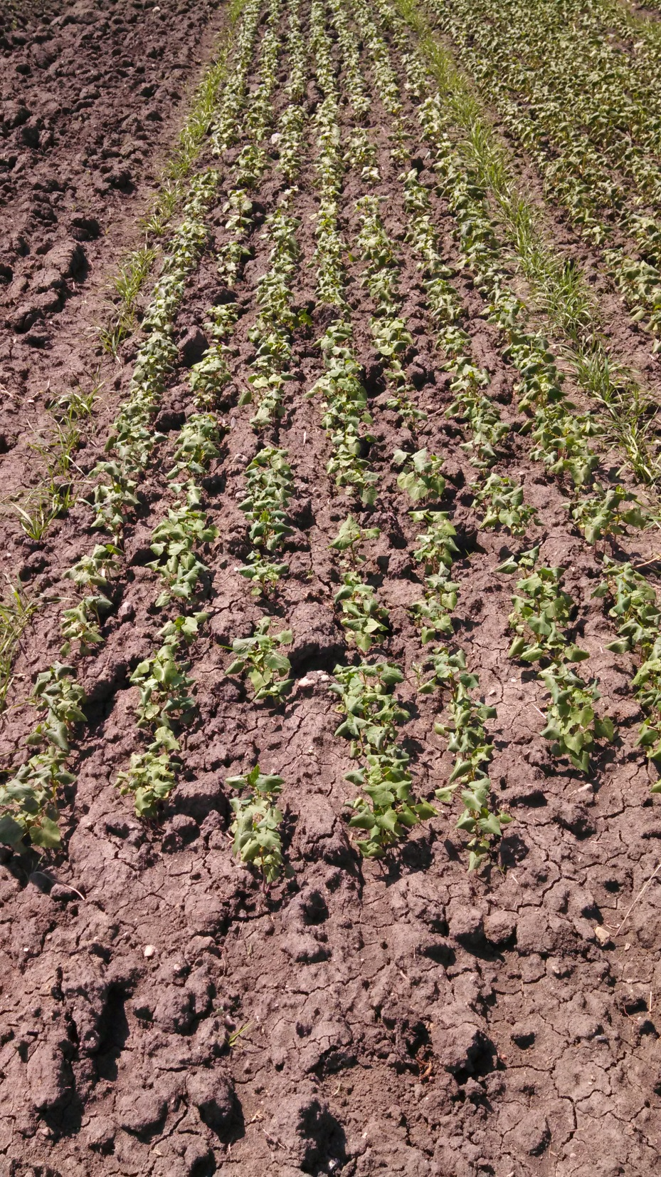
2013 increase
Devyatka increase
Anne’s farm
600 gms sown, June 12
Swathed, August 27
Harvested, September 3
Increase yielded ~55 lbs

Slide 8
2014 Seeding Devyatka Increase

Slide 9
Devyatka seed

Slide 10
2014 Variety Trials

Slide 11
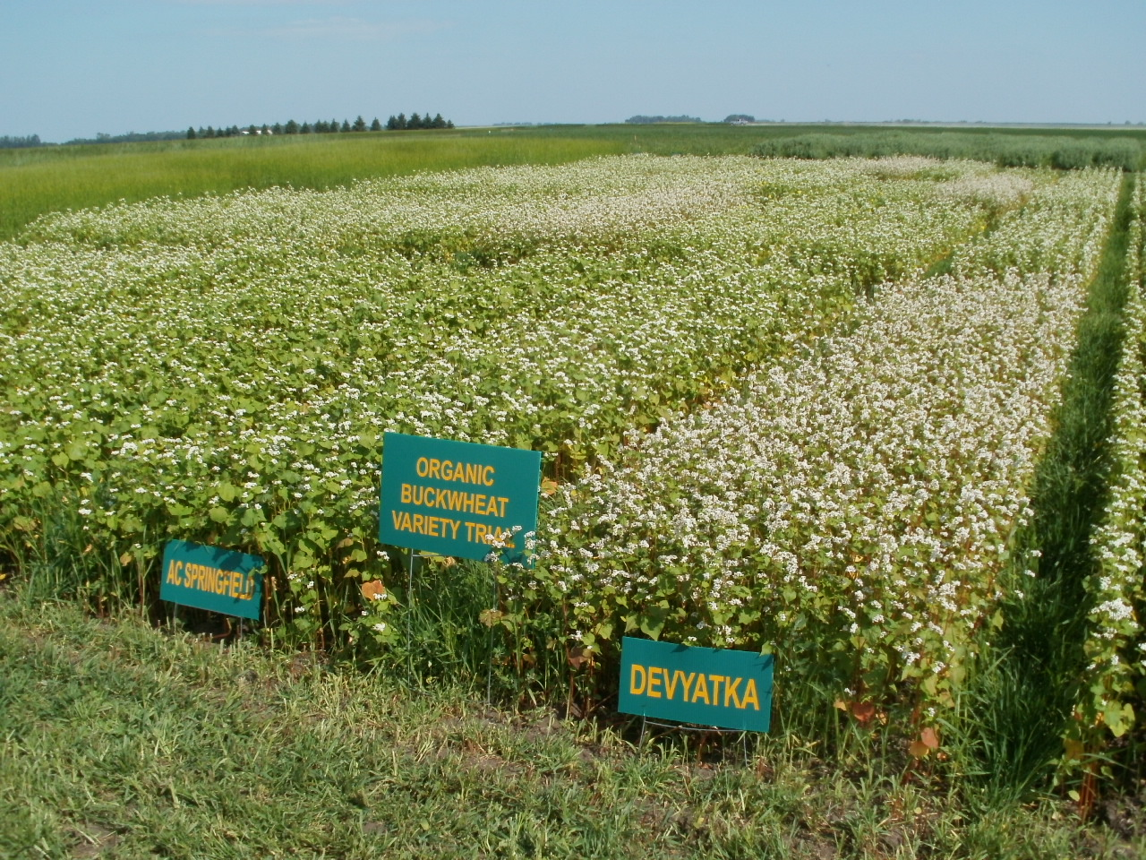
2014 CREC Organic Variety Trial

Slide 12
2014 buckwheat trials 3 site average

Slide 13
2014 buckwheat trials 3 site average plant height

Slide 14
2014 buckwheat trials 3 site average

Slide 15
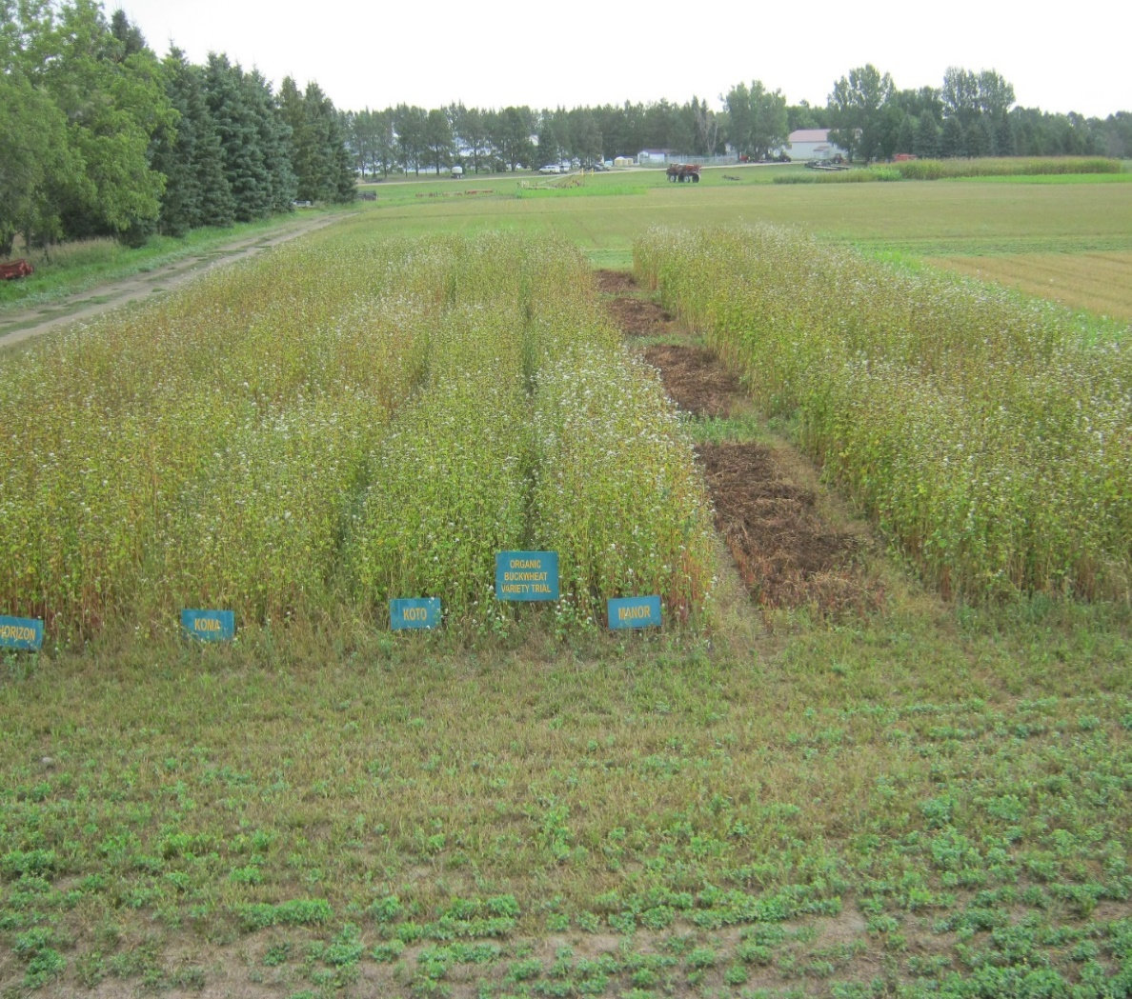
2019 increase
Planted-May 31
Swathed-August 19
Harvest-August 29
Planted~3 lbs
Harvest 99.5 lbs or 1179 lbs/ac
2020 increases
Owen Transgrud
Planted-June 13
Swathed-September 2
Harvest-September 12
Harvest 3740 lbs or 2077 lbs/ac
CREC
Backup increase harvest 71lbs or 1085 lbs/ac

Slide 19
2020 organic buckwheat variety trial-NDSU CREC

Slide 20
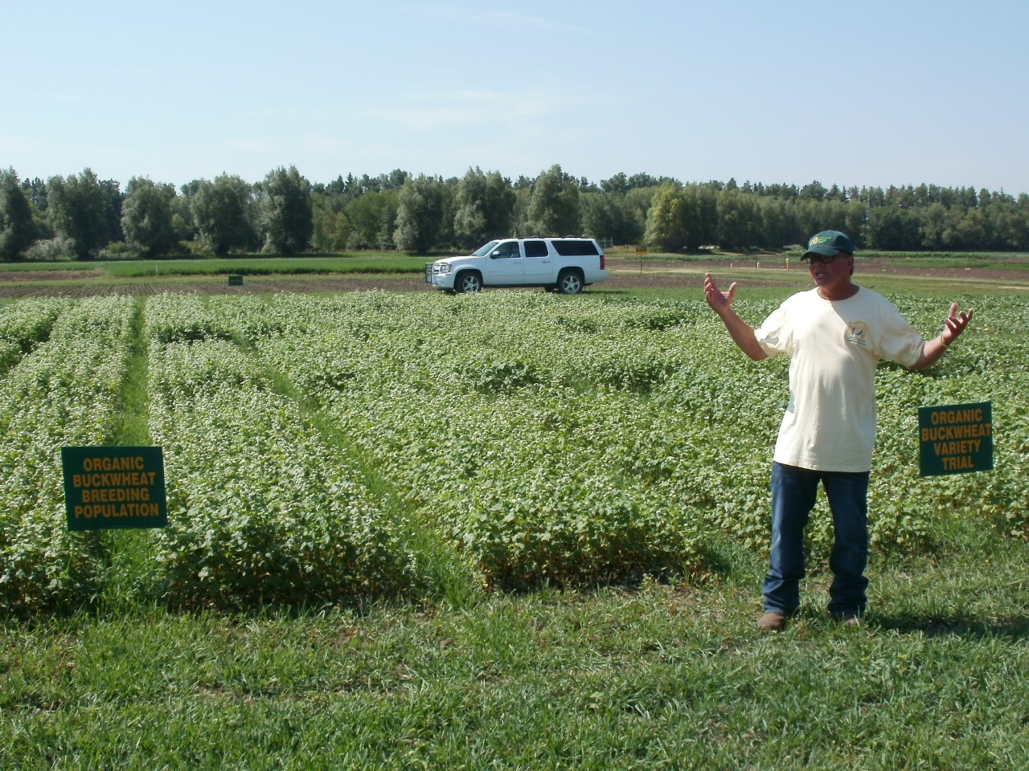
Where do we go from here?
S
Notes:
Steve

Slide 21
Thank You!

